Slide 1
CNN經典模型

Slide 2
Evolutionary history of deep CNNs
A Survey of the Recent Architectures of Deep Convolutional Neural Networks
https://arxiv.org/abs/1901.06032

Slide 3
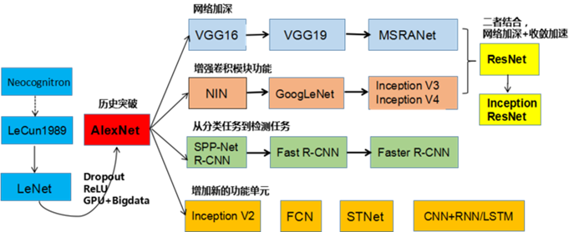
https://medium.com/@rgnuj122/lenet%E6%89%8B%E6%8A%8A%E6%89%8B%E5%AF%A6%E4%BD%9C%E6%95%99%E5%AD%B8-1c2f149c822f

Slide 4
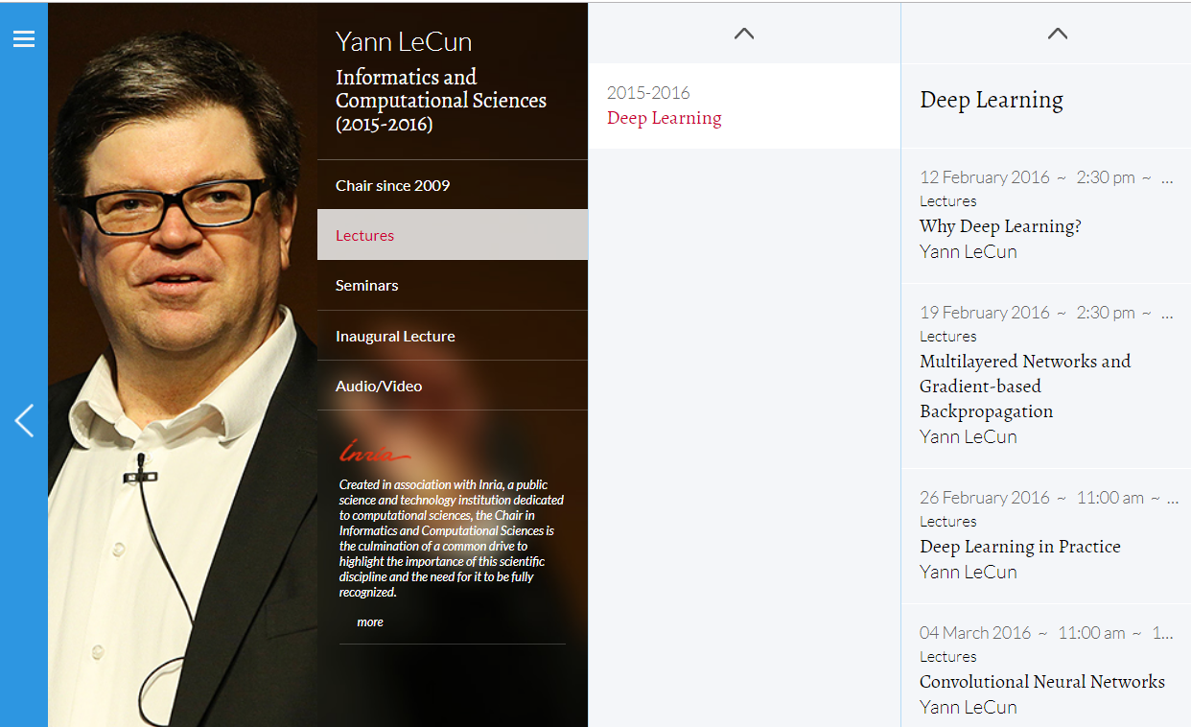
https://www.college-de-france.fr/site/en-yann-lecun/course-2015-2016.htm

Slide 5
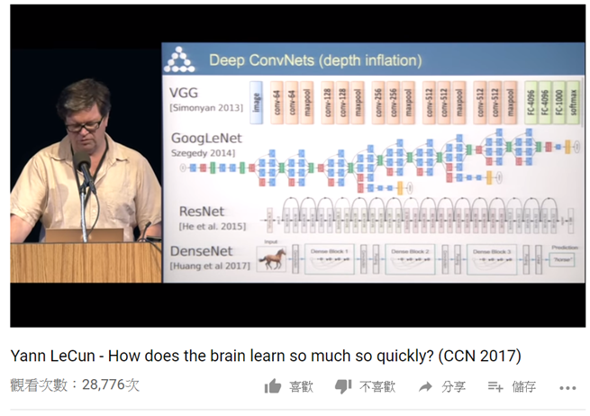
https://www.youtube.com/watch?v=cWzi38-vDbE
Presented at Cognitive Computational Neuroscience (CCN) 2017 (http://www.ccneuro.org) held September 6-8, 2017.

Slide 6
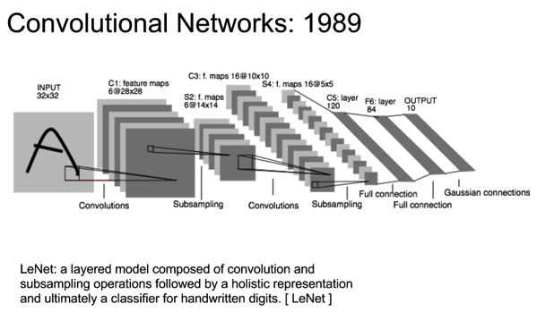

Slide 7
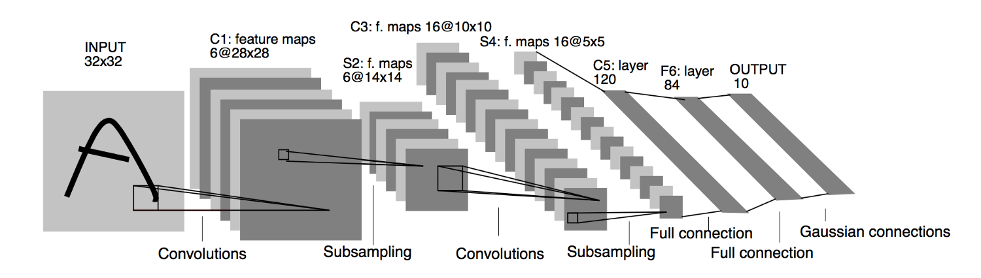
A Survey of the Recent Architectures of Deep Convolutional Neural Networks
https://arxiv.org/abs/1901.06032

Slide 8
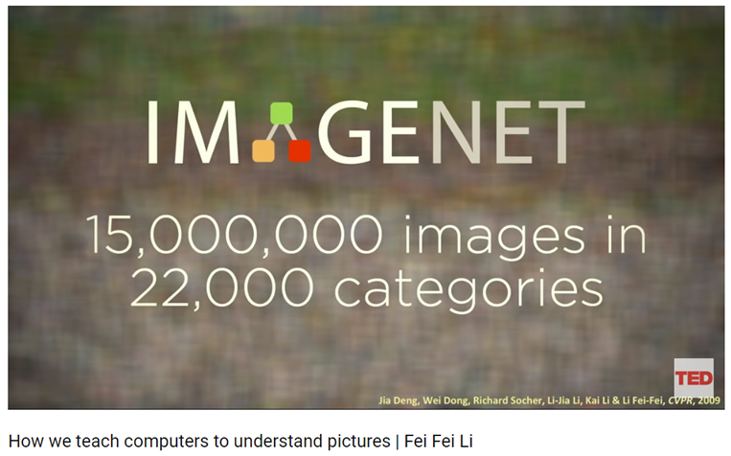
ImageNet (since 2009)
ImageNet Large Scale Visual Recognition Challenge (ILSVRC) was founded in 2010
How we teach computers to understand pictures | Fei Fei Li
https://www.youtube.com/watch?v=40riCqvRoMs

Slide 9
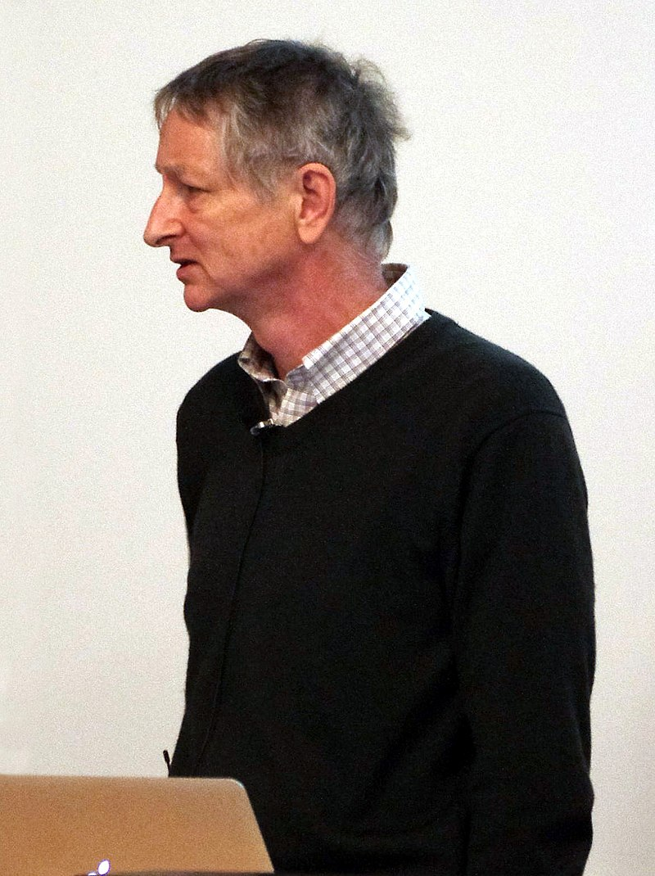
Godfather of Deep Learning
重要里程碑
1986 :the backpropagation algorithm for training multi-layer neural networks
https://www.cs.toronto.edu/~hinton/
Hinton, G. E., Osindero, S. and Teh, Y. (2006)
A fast learning algorithm for deep belief nets.
Neural Computation, 18, pp 1527-1554
2012 AlexNet ( Alex Krizhevsky)啟動AI/NN電腦視覺熱潮
2018 Turing Prize (Yoshua Bengio and Yann LeCun )
2012年在coursera開設課程的簡報https://www.cs.toronto.edu/~hinton/coursera_slides.html

Slide 10
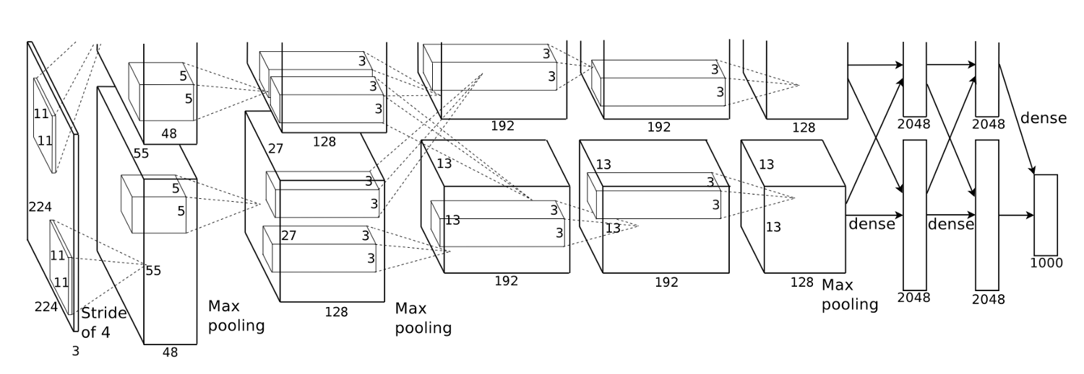
AlexNet(2012)::大突破
Hinton學生Alex Krizhevsky於2012年提出並拿下ILSVRC”12的冠軍讓CNN重返榮耀
其將top-5 error減少至15.3% ， outperform同年度第二名26.2%
LeNet5的加強版
主要的新技術與應用::將ReLU, Dropout, LRN加到model中
用GPU來加快training效率
data augmentation增加訓練資料集

Slide 11
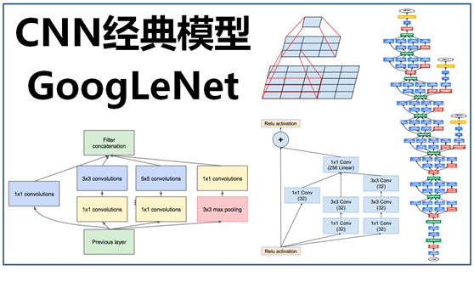
GoogLeNet(2014)
https://www.itread01.com/content/1544969366.html

Slide 12
GoogLeNet architecture
In 2014, ILSVRC, Google published its own network known as GoogLeNet. Its performance is a little better than VGGNet; GoogLeNet's performance is 6.7% compared to VGGNet's performance of 7.3%.
The main attractive feature of GoogLeNet is that it runs very fast due to the introduction of a new concept called inception module, thus reducing the number of
parameters to only 5 million; that's 12 times less than AlexNet.
It has lower memory use and lower power use too.
It has 22 layers, so it is a very deep network. Adding more layers increases the number of parameters and it is likely that the network overfits. There will be more computation,
because a linear increase in filters results in a quadratic increase in computation. So, the
designers use the inception module and GAP. The fully connected layer at the end of the network is replaced with a GAP layer because fully connected layers are generally prone to overfitting. GAP has no parameters to learn or optimize.

Slide 13
Inception V1
Inception V2
Inception V3
Inception V4

Slide 14
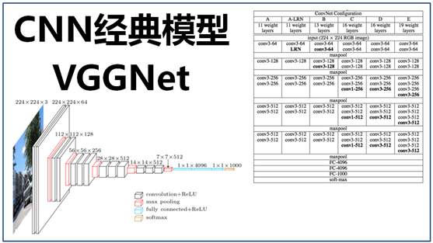
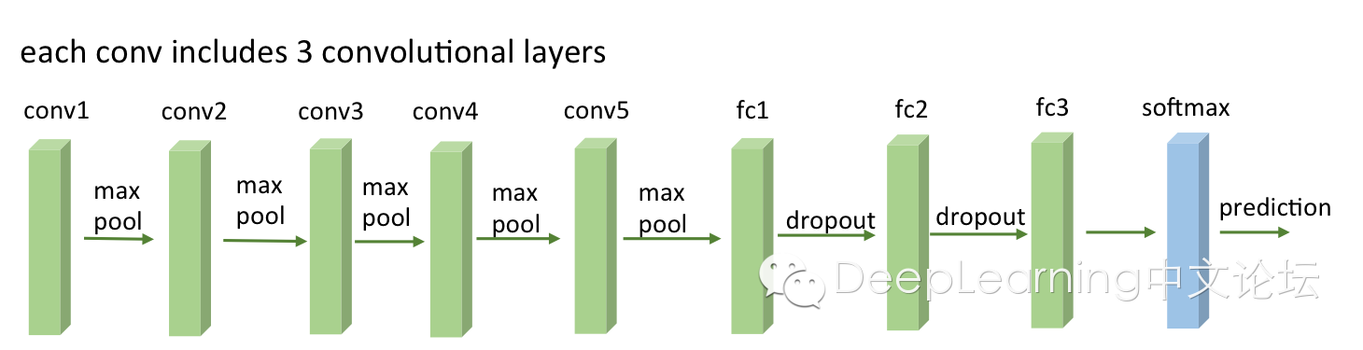
https://www.itread01.com/content/1541992744.html

Slide 15
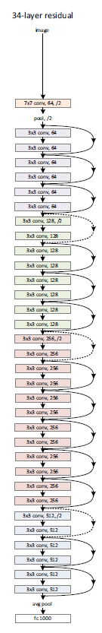
ResNet(2015) Deep Residual Learning
最深的model
採用的152層

Slide 16
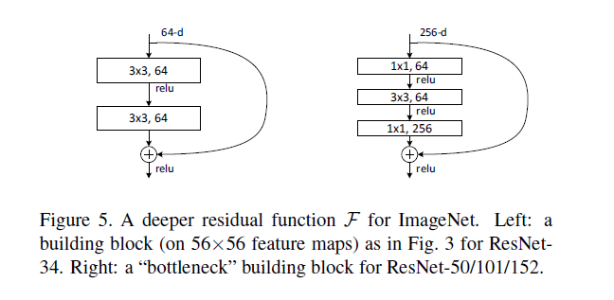
https://www.itread01.com/content/1541992744.html

Slide 17
In the 2015 ImageNet ILSVRC competition, the winner was ResNet from Microsoft, with an
error rate of 3.57%. ResNet is a kind of VGG in the sense that the same structure is repeated
again and again to make the network deeper. Unlike VGGNet, it has different depth
variations, such as 34, 50, 101, and 152 layers. It has a whopping 152 layers compared to
AlexNet 8, VGGNet's 19 layers, and GoogLeNet's 22 layers. The ResNet architecture is a
stack of residual blocks. The main idea is to skip layers by adding connections to the neural
network. Every residual block has 3 x 3 convolution layers. After the last conv layer, a GAP
layer is added. There is only one fully connected layer to classify 1,000 classes. It has
different depth varieties, such as 34, 50, 101, or 152 layers for the ImageNet dataset. For a
deeper network, say more than 50 layers, it uses the bottleneck features concept to improve
efficiency. No dropout is used in this network.

Slide 18
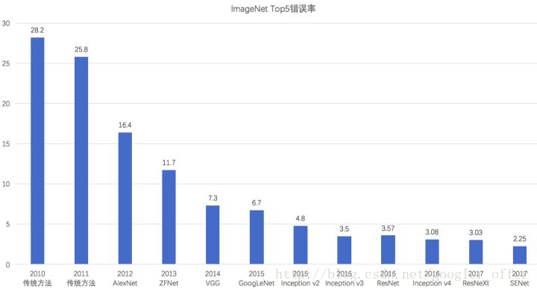
ImageNet上的分類錯誤率逐年降低
且已經低於人類的錯誤率（5.1%）

Slide 19
SENet::Squeeze-and-Excitation Networks(2017-2019)
https://arxiv.org/abs/1709.01507
Caffe實作
https://github.com/hujie-frank/SENet
The central building block of convolutional neural networks (CNNs) is the convolution operator, which enables networks to construct informative features by fusing both spatial and channel-wise information within local receptive fields at each layer.
A broad range of prior research has investigated the spatial component of this relationship, seeking to strengthen the representational power of a CNN by enhancing the quality of spatial encodings throughout its feature hierarchy.
In this work, we focus instead on the channel relationship and propose a novel architectural unit, which we term the "Squeeze-and-Excitation" (SE) block, that adaptively recalibrates channel-wise feature responses by explicitly modelling interdependencies between channels. We show that these blocks can be stacked together to form SENet architectures that generalise extremely effectively across different datasets. We further demonstrate that SE blocks bring significant improvements in performance for existing state-of-the-art CNNs at slight additional computational cost. Squeeze-and-Excitation Networks formed the foundation of our ILSVRC 2017 classification submission which won first place and reduced the top-5 error to 2.251%, surpassing the winning entry of 2016 by a relative improvement of ~25%. Models and code are available at this https URL.

Slide 20
Tensorflow 實作
https://github.com/taki0112/SENet-Tensorflow
PyTorch 實作
https://github.com/moskomule/senet.pytorch
Keras 實作
https://github.com/titu1994/keras-squeeze-excite-network
https://github.com/yoheikikuta/senet-keras
說明文件
https://blog.csdn.net/u014380165/article/details/78006626
keras瞎搞系列-從LeNet到SENet——卷積神經網路回顧
https://blog.csdn.net/googler_offer/article/details/79478893

Slide 21
Xception(2017)
Xception: Deep Learning with Depthwise Separable Convolutions
François Chollet [KERAS創造者]
https://arxiv.org/abs/1610.02357
深度可分離卷積(Depthwise Separable Convolution)

Slide 22
Densely Connected Convolutional Networks Gao Huang, Zhuang Liu, Laurens van der Maaten, Kilian Q. Weinberger https://arxiv.org/abs/1608.06993
DenseNet(2018)
相較於ResNet, DenseNet 可用更少的訓練參數取得更佳的準確率
CVPR 201 7 最佳論文
Keras 提供數個DenseNet 版本供我們使用
： DenseNet 121 、DenseNet 169 、DenseNet201
connects each layer to every other layer in a feed-forward fashion

Slide 23
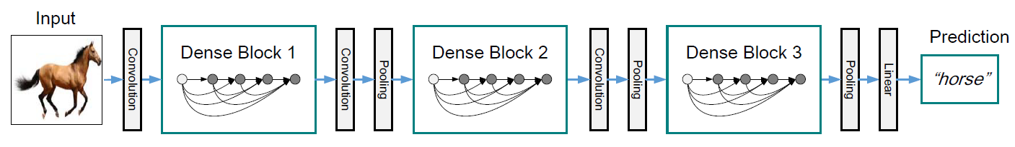
DenseNet architectures for ImageNet
過渡層
→ BN-ReLU-Conv
全域平均池化
each “conv” layer shown in the table corresponds the sequence BN-ReLU-Conv

Slide 24
Topic
使用tf.keras.applications 模組

Slide 25
https://www.tensorflow.org/api_docs/python/tf/keras/applications
densenet module: DenseNet models for Keras.
imagenet_utils module: Utilities for ImageNet data preprocessing & prediction decoding.
inception_resnet_v2 module: Inception-ResNet V2 model for Keras.
inception_v3 module: Inception V3 model for Keras.
mobilenet module: MobileNet v1 models for Keras.
mobilenet_v2 module: MobileNet v2 models for Keras.
nasnet module: NASNet-A models for Keras.
resnet module: ResNet models for Keras.
resnet50 module: Public API for tf.keras.applications.resnet50 namespace.
resnet_v2 module: ResNet v2 models for Keras.
vgg16 module: VGG16 model for Keras.
vgg19 module: VGG19 model for Keras.
xception module: Xception V1 model for Keras.

Slide 26
from tensorflow.keras.applications import Xception
xception = Xception()
xception.summary()

Slide 27
CNN Models

Slide 28
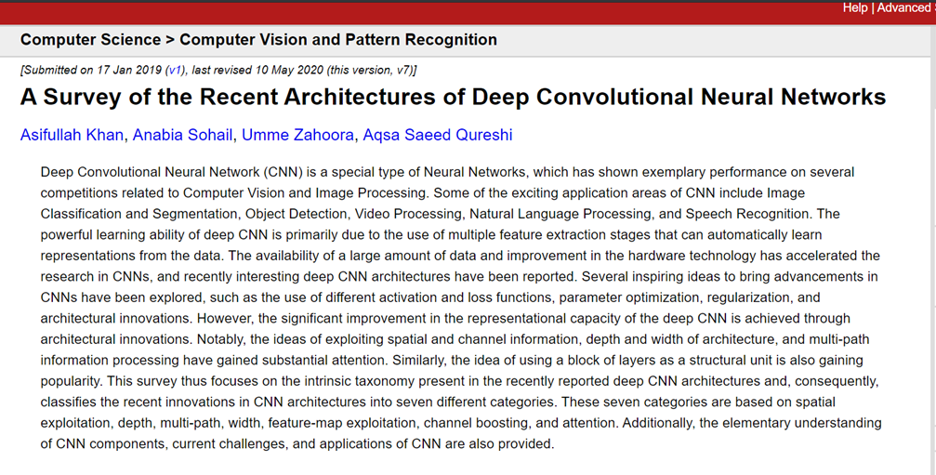
https://arxiv.org/abs/1901.06032

Slide 31
Evolutionary history of deep CNNs

Slide 32
Taxonomy of deep CNN architectures

